Slide 1
Screening Diabetic Retinopathy With Machine Learning
Richie Bui

Slide 2
Table Of Content
Overview of DR
Analysis of Data
Results
Problems with DR
Approach
Improvements
Project objective
Implementation
Sources
Stages of DR
Metrics

Slide 3
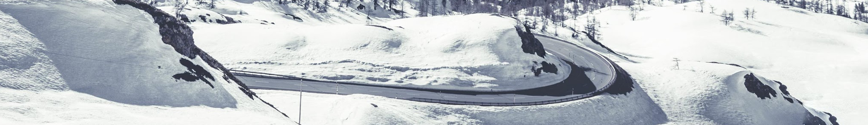
Overview of Diabetic Retinopathy
The retina is the inside layer of the eye and its main purpose is to transmit light into vision. Diabetes affects the body by constricting the blood vessels. When the blood vessels in the eye begin to constrict, it will begin to leak blood into the eye and damage the retina. After a long exposure, it can typically cause blindness in severe cases. Since the disease is slow moving and shows no symptoms until it becomes severe, it becomes difficult to treat if not properly screened.

Slide 4
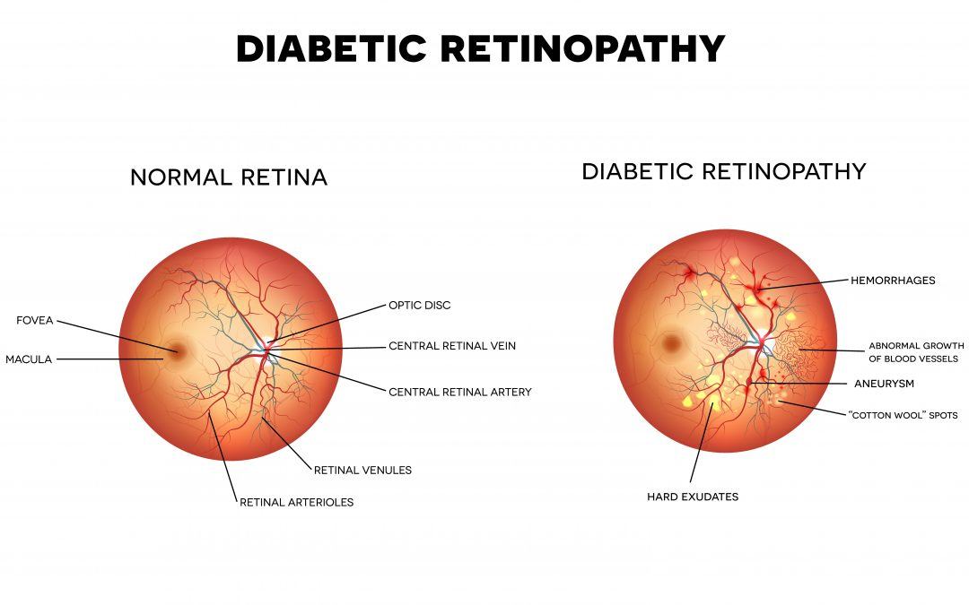

Slide 5
4 Stages of Diabetic Retinopathy 01
Mild Nonproliferative Retinopathy:
Small areas of blood vessels sweat and balloon
Microaneurysms
Severe Nonproliferative Retinopathy:
Blood vessels are blocked
Depriving blood supply to parts of the retina
Begins to grow new blood vessels
1
3
2
Moderate Nonproliferative Retinopathy:
Blood vessels continue to swell and become distorted
4
Proliferative Retinopathy:
Formation of too many blood vessels
Vessels are weak, likely to bleed/leak
Scar tissue can shift, cause retinal detachment, permanent vision loss

Slide 6
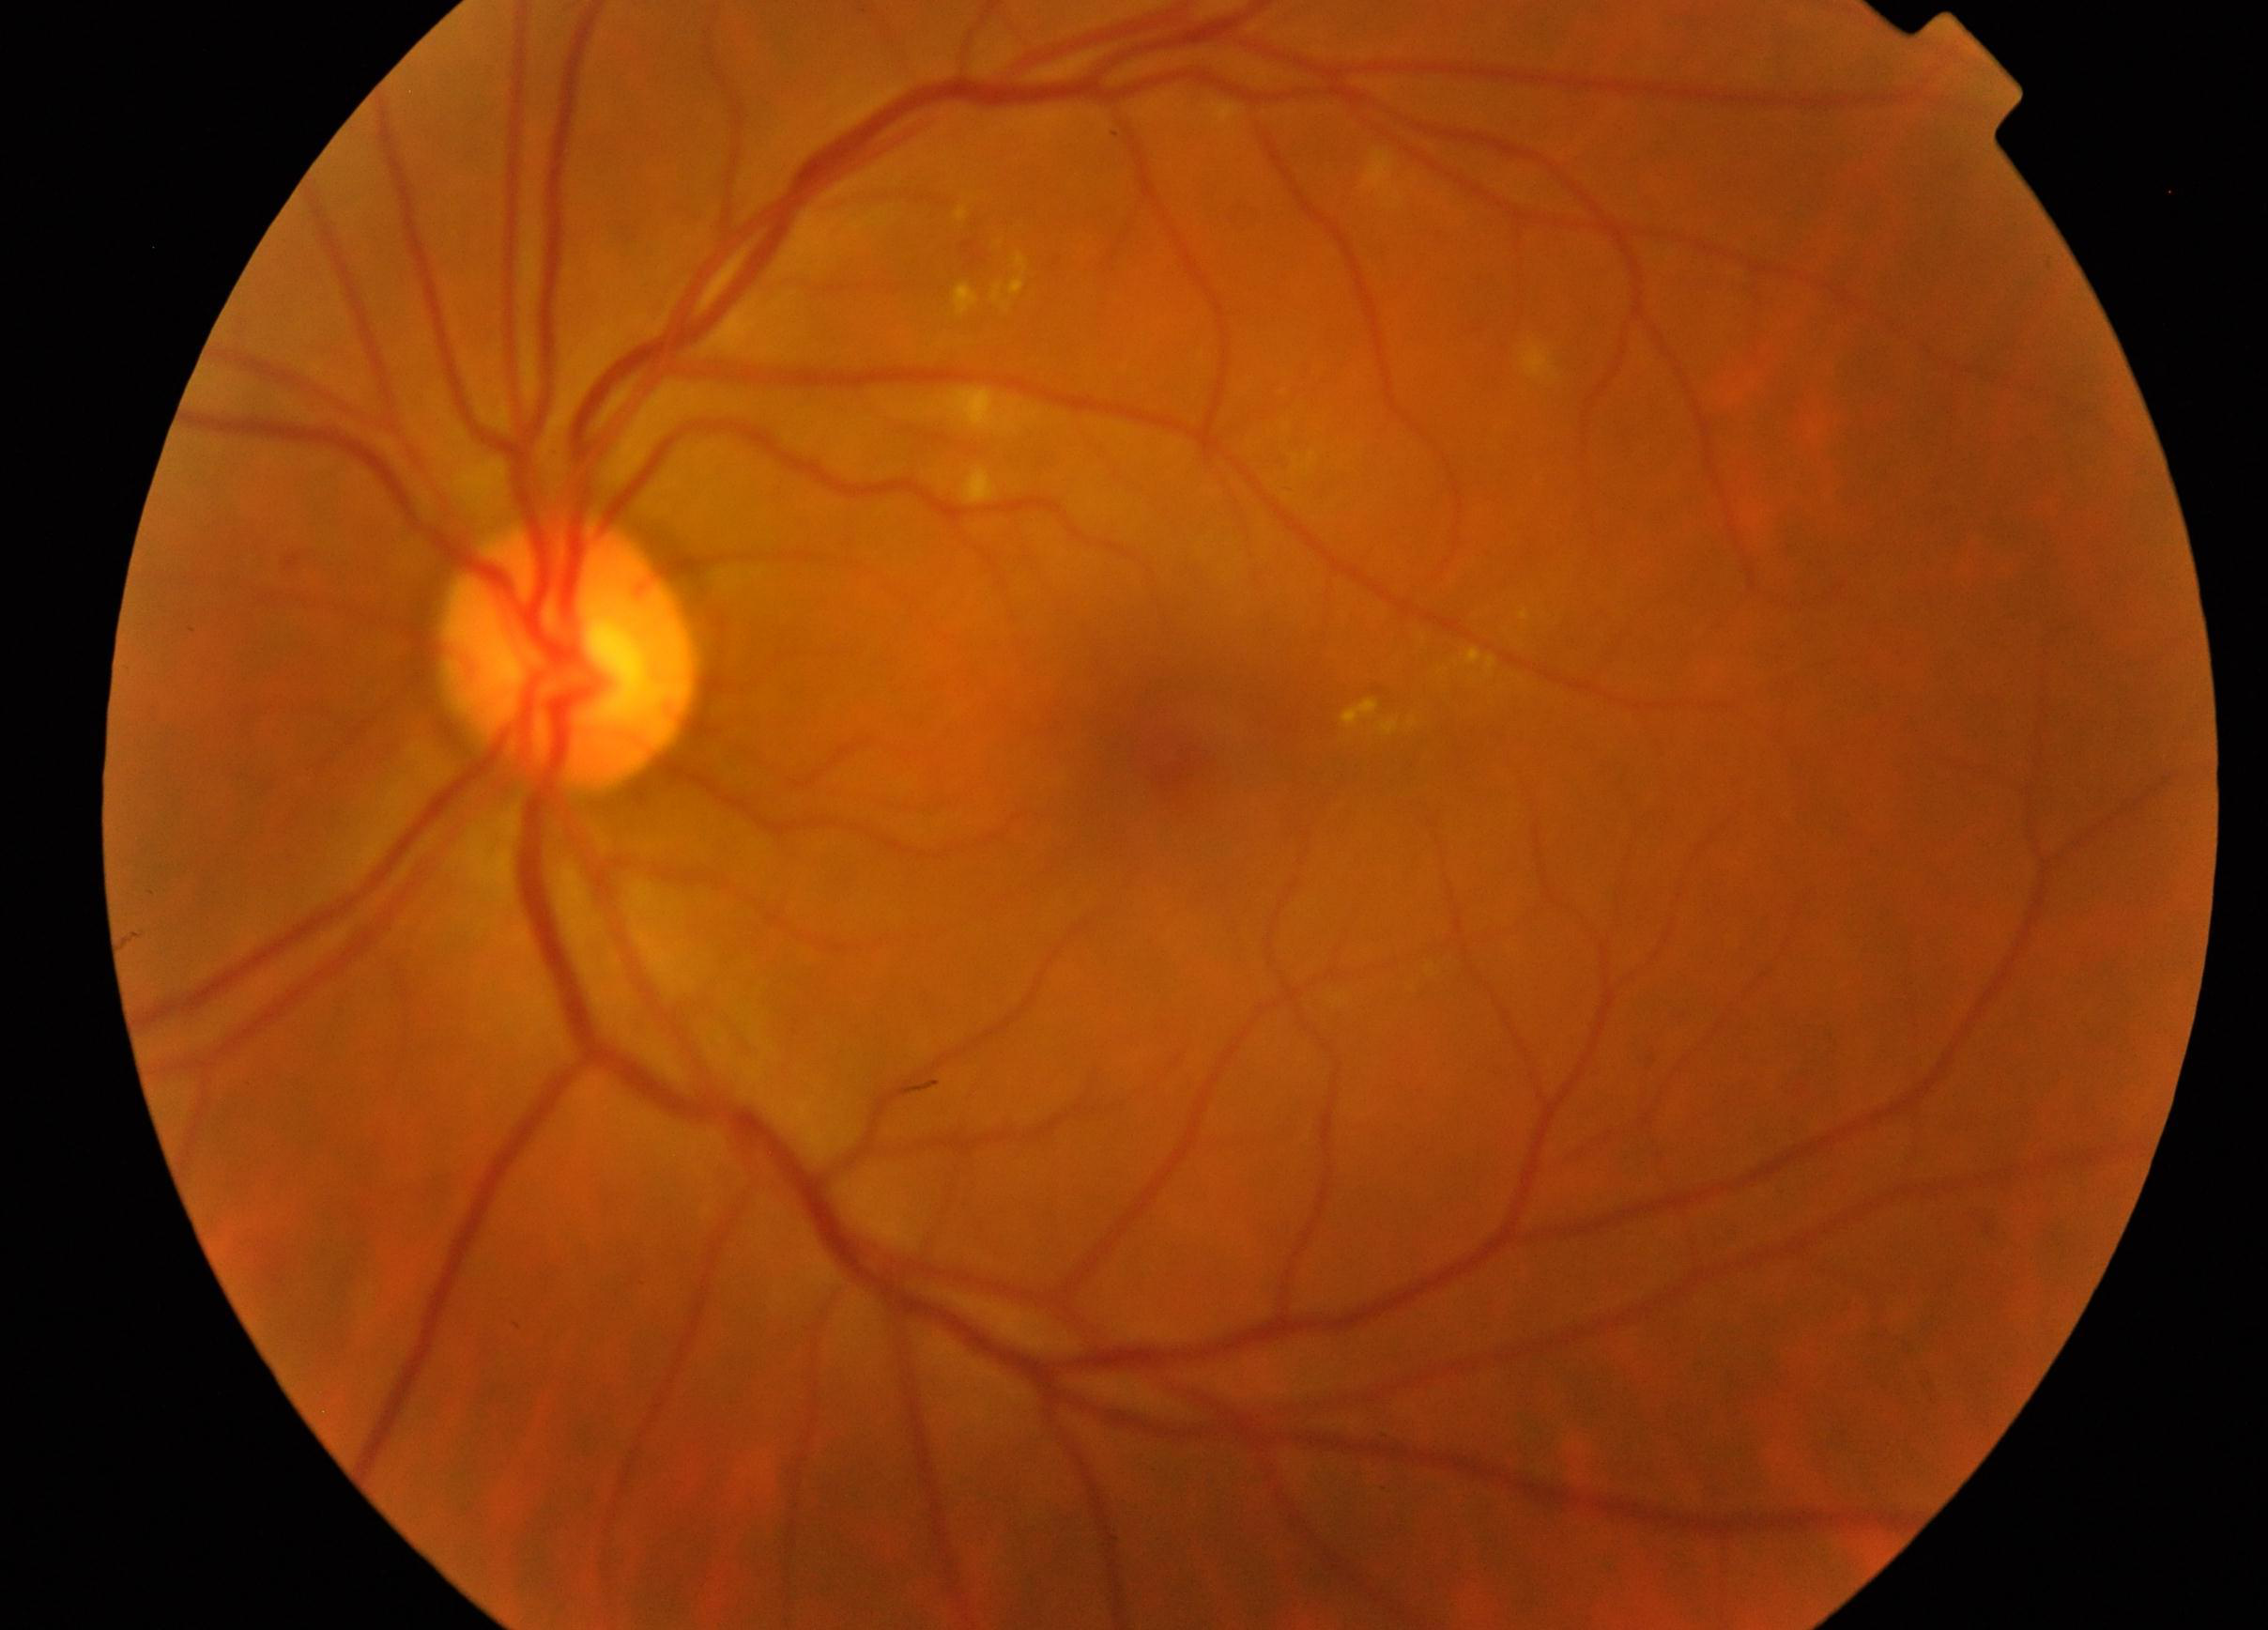
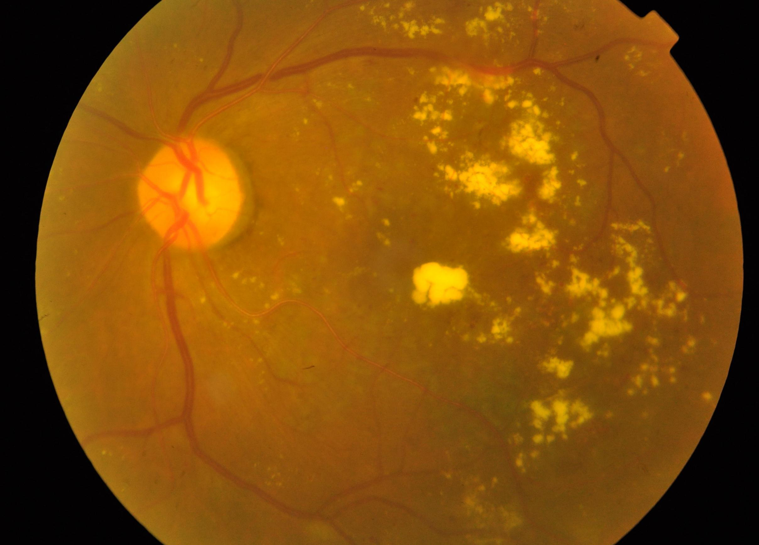
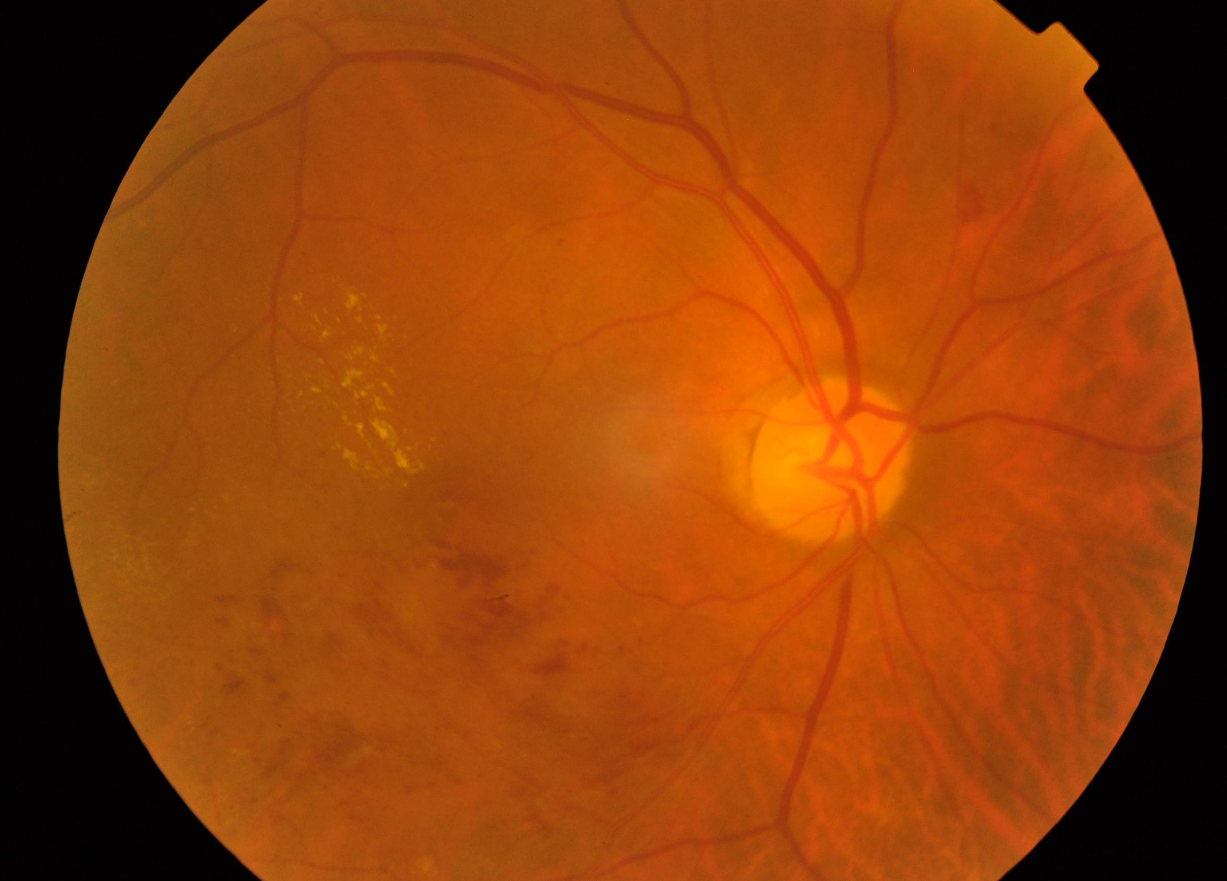
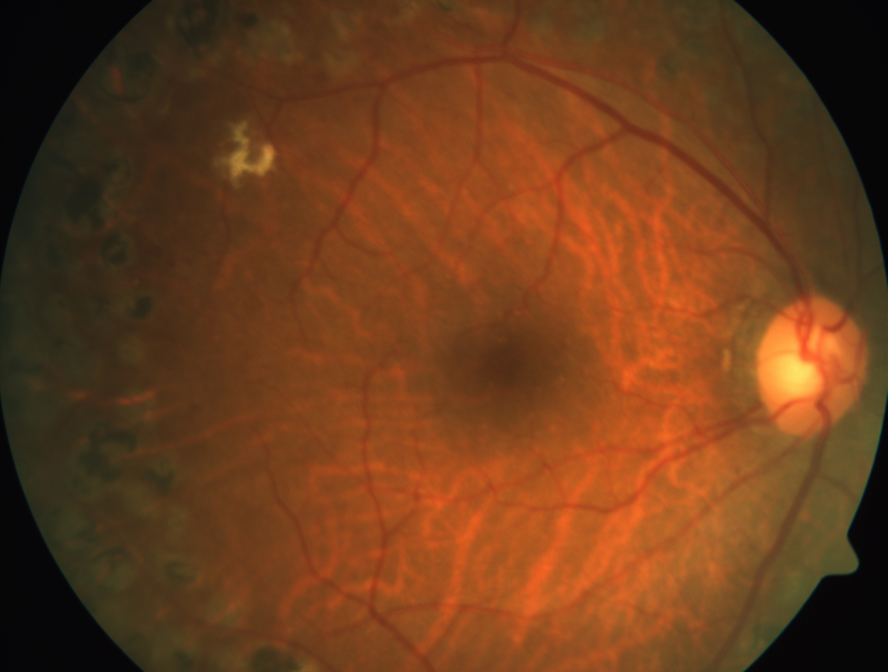
4 Stages of Diabetic Retinopathy 02
Mild Nonproliferative Retinopathy:
Severe Nonproliferative Retinopathy:
1
3
2
Moderate Nonproliferative Retinopathy:
4
Proliferative Retinopathy:

Slide 7
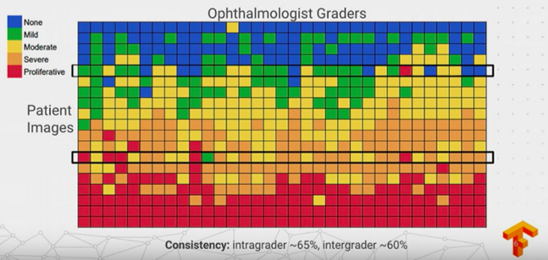

Slide 8
Model objective
Over millions of people are affected by this disease and rely heavily on trained doctors to screen, detect and prevent diabetic retinopathy. Thanks to the Asian-Pacific Tele-Ophthalmology Society (APTOS) providing the data to use a machine learning model to help speed the process of screening. The overall goal of this project is to not only prevent lifelong blindness, but to further help detect other diseases in the future such as glaucoma and macular degeneration.

Slide 9
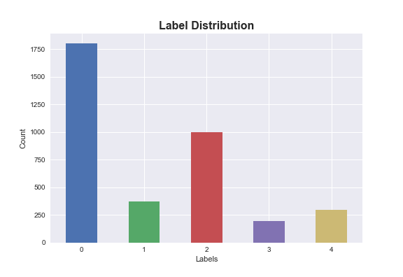
Analysis
01
The data that was given provided over 3600 training images with labels and over 1900 testing images to test on. From the image on the right you can see that the label distribution seem to be heavily focused on the healthy eye. While the rest is labeled with one of the four stages of diabetic retinopathy. There is a slight imbalance and should keep this in mind if there is not enough data to work with in the end.
.Data:
3662 training images
Label 0: 1805 Label 3: 193
Label 1: 370 Label 4: 295
Label 2: 999

Slide 10
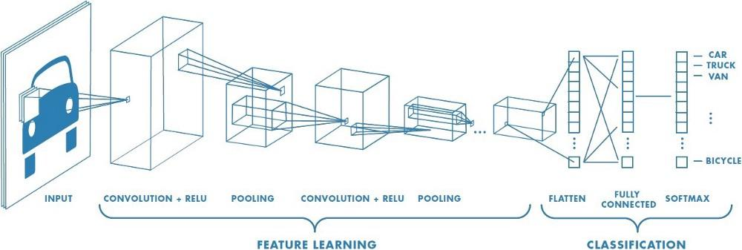
Approach
02
Since this was a multi-labeled classification with images, I thought that the first model to start off with is a convolutional neural network. Using CNN in the medical field has been proven to cause some major breakthroughs and continue to do so by how powerful this method is. Typically, starting off a CNN model fresh can be often times time-consuming, computationally expensive and require a large amount of data. This is where I thought we would be able to use a pretrained model to start.

Slide 11
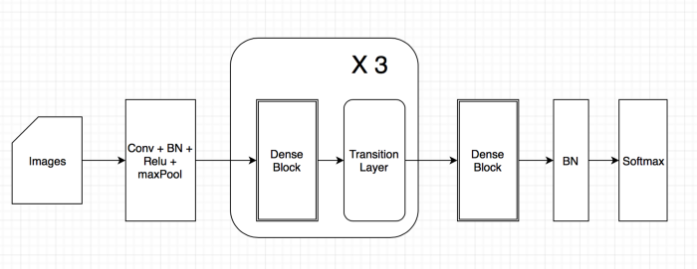
Which Pretrained Model?
Using a pretrained model helps speed up the process when it comes to trying to find the results we want. However, there are an abundant amount of pretrained models, which one is best for our case?

Slide 12
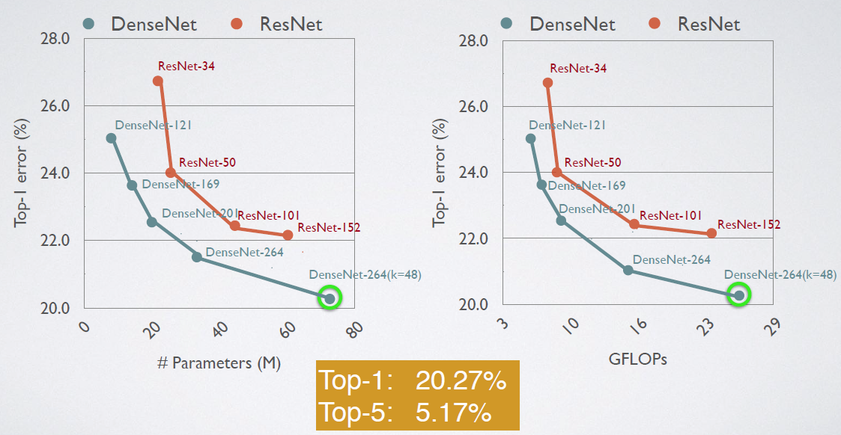
It would seem the most popular pretrained models that are used are DenseNet and ResNet. ResNet is fairly popular amongst researchers and continue to find ways to improve its model performance. However, DenseNet has recently popularity in the machine learning community as it has slowly become more efficient in terms of parameters and computation to produce similar results.
DenseNet vs Resnet
DenseNet
Requires less parameters than conventional CNN.
Uses a lot more memory.
ResNet
Uses more parameters and computational power
Trains fast and accurate results

Slide 13
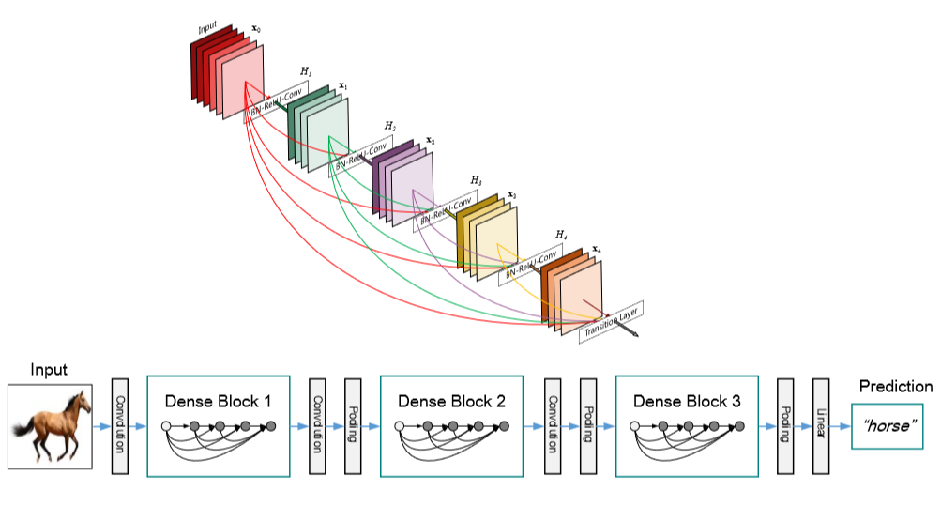
Implementation
Fitting the model to our pretrained network. We’ll off by preprocessing the image to a (224, 224, 3) for our input shape. Create a function that builds our model and complile our metrics.
01 | Sequential
02 | DenseNet121
03 | Global Average Pooling
04 | Dropout
05 | Dense

Slide 14
Image Data Generator
Creating a image generator allows us to generate batches of tensor images with real-time data augmentation. This lets the model loop through each batch of data and randomly flip the images to help prevent the model to overfitting. It helps for not having to hold the entire dataset all at once, but little at a time.

Slide 15
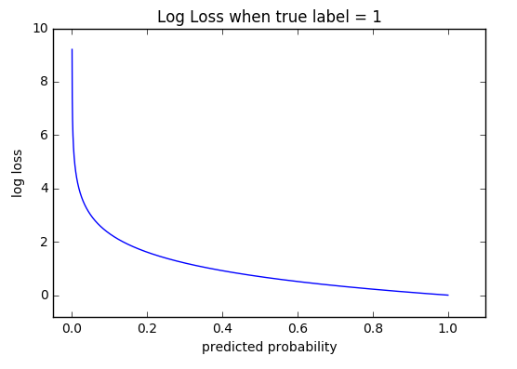
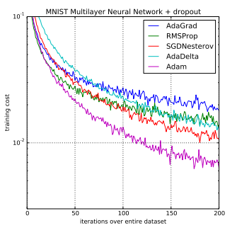
Metrics
Optimizer = “Adam”
Loss: “Binary Cross-Entropy”
Quadratic Weighted Kappa
Quadratic Weighted Kappa
One of the more popular optimizers that take into account of AdaGrad and RMSProp. The learning rate will be set at (0.00005).
Measures the performance of the model whose output probability is between 0 and 1. This loss function penalizes both types of errors and esp. When it is confidently wrong.
Weighted Kappa is a metric that measures the amount of similarities between the predictions and actuals. 1 being in perfect agreement and -1 for being completely in disagreement.

Slide 16
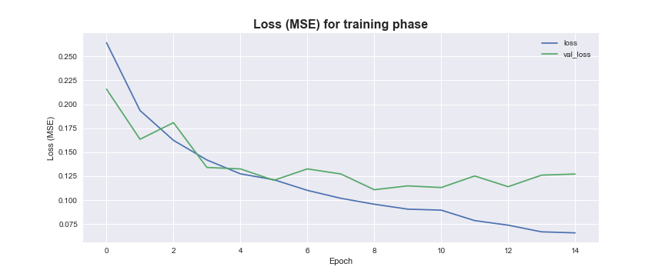
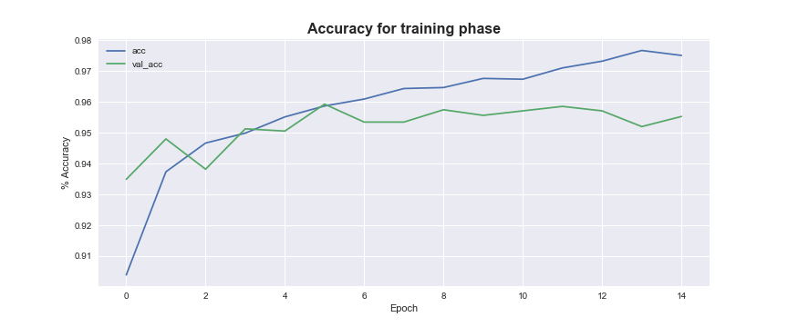
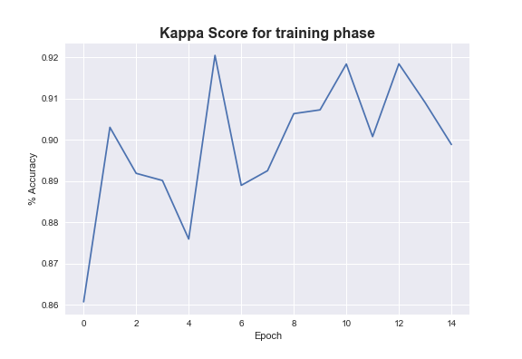
Results
Started the model by setting the epoch to 15 and splitting the data by 85% train and 15% validation test with a batch size of 32. The callback function, we used our own custom QWK and would save anytime there was an improvement on our kappa score since this is our biggest focus for metrics.
Loss
Accuracy
Kappa Score

Slide 17
Kaggle
Results
Our kaggle score displayed a 74% on the test images with the highest leaderboard of 84%. This may be far from the top but it is an improvement over the trained ophthalmologist of 60%. This maybe be far from perfect, but ultimately leaves room for improvement.
Loss
Accuracy
Kappa Score

Slide 18
Improvements
Crop photos
Change preprocess method
Switch pretrained models
Increase epochs
Switch loss functions

Slide 19
Sources
Jason Brownlee, PhD. Gentle Introduction to the Adam Optimization Algorithm for Deep Learning. https://machinelearningmastery.com/adam-optimization-algorithm-for-deep-learning/
Jianxin Wu (2017). Introduction to Convolutional Neural Networks. https://pdfs.semanticscholar.org/450c/a19932fcef1ca6d0442cbf52fec38fb9d1e5.pdf
Gao Huang (2016) Densely Connected Convolutional Networks. https://arxiv.org/abs/1608.06993?source=post_page---------------------------
Quadratic Kappa Metric Explained. https://www.kaggle.com/aroraaman/quadratic-kappa-metric-explained-in-5-simple-steps
CEO
CFO
Sales Director
Berry Books
Vinny Viewer
Wendy Writer

Slide 20
Thank you.

